Slide 1
Unified mentor FrontEnd Development Internship :
Tic-Tac-Toe
My Portfolio
Weather App
To-Do App
Basic Calculator
Recipe Book
Music Player
Interactive Resume
Info
Graphics
Virtual Pet Simu
Thispresentationshowcaseswebdevelopmentproject:Memory Card Game .ThisprojectutilizeHTML,CSS, andJavaScript,demonstratingmycodingskillsandprojectdevelopment experience.Thisprojecthighlightmyabilitytocreateinteractiveandengaging webapplications,showcasingmypassionforwebdevelopmentandcommitment tobuildinghigh-quality, user-friendlywebsite.
A Web Development Showcase
Memory Card Game
Interactive Quiz
Countdown Timer
Blog Website
Virtual Art gallery
byMandadiRohitReddy
InternshipID:UMIP278665
M R
Chat Application
Interactive Story telling
Interactive Map
Image Slider
Expense Tracker

Slide 2























Project: Memory Card Game in HTML,CSS and JS
“Train your brain, one card at a time.”
byMandadiRohitReddy
InternshipID:UMIP278665

Slide 3
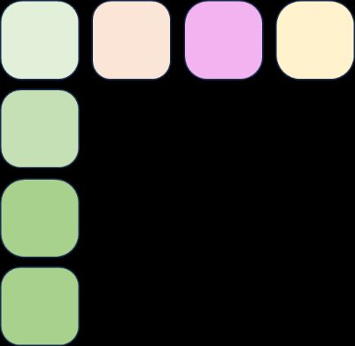





Introduction
🧠 Project: Memory Card Game
The Memory Card Game is a fun and interactive web-based game developed using HTML, CSS, and JavaScript. It challenges players to test and improve their memory by flipping cards and finding matching pairs.
The game begins with a grid of face-down cards. Players can flip two cards at a time, aiming to find matching pairs. If the cards match, they remain face-up; otherwise, they flip back over. The goal is to match all pairs in the fewest number of moves and the shortest time possible.

Slide 4


Technologies Used:
HTML:
CSS:
JavaScript:
for the structure of the game board and elements
for styling and animations to enhance visual appeal
for the game logic, such as card flipping, matching, and scoring

Slide 5


🎯 Key Features:
Responsive and user-friendly interface
Flip card animation effects
Move counter and timer
Game reset functionality

Slide 6
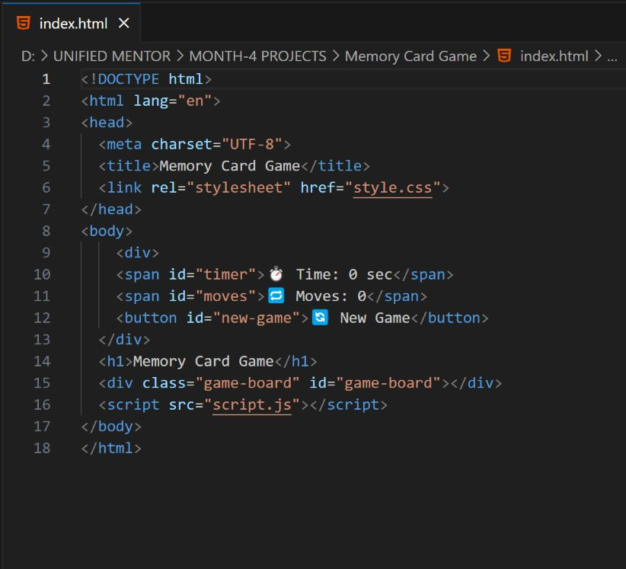
HTML code

Slide 7
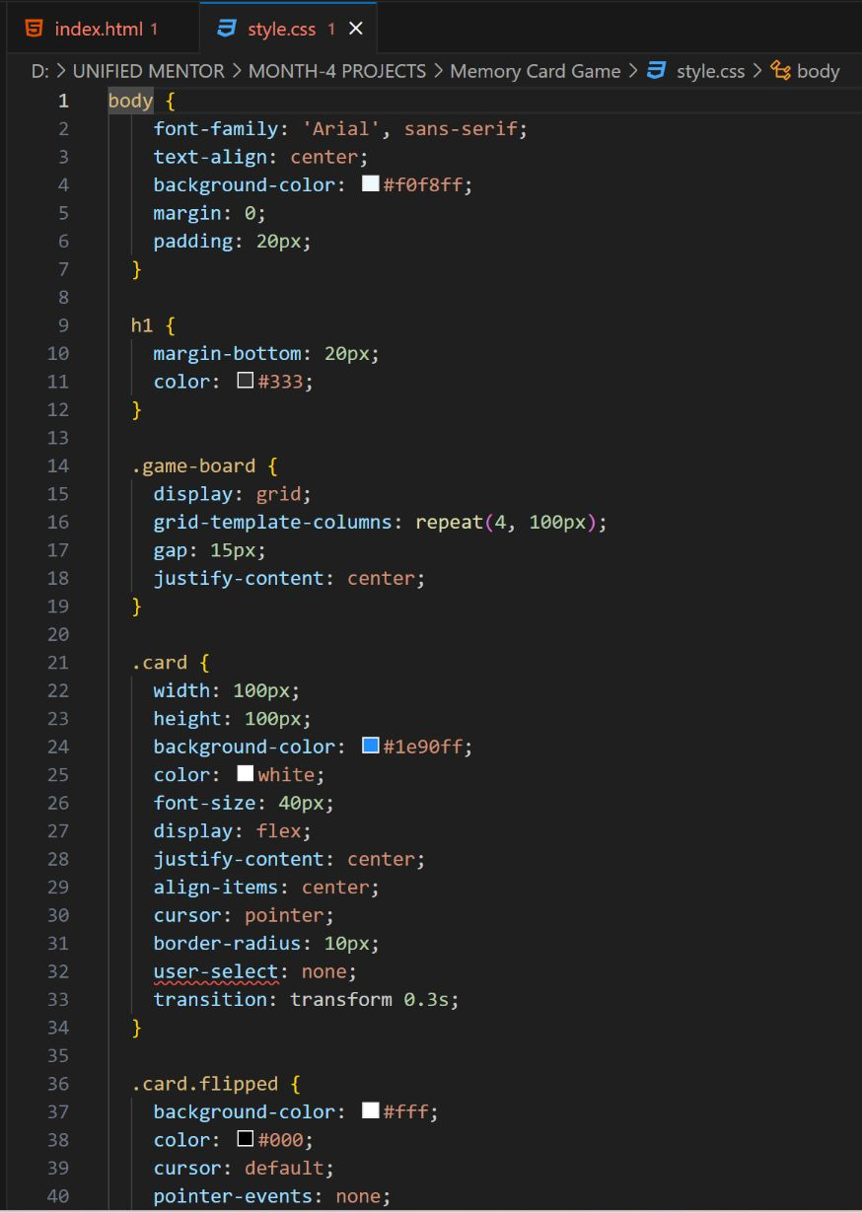
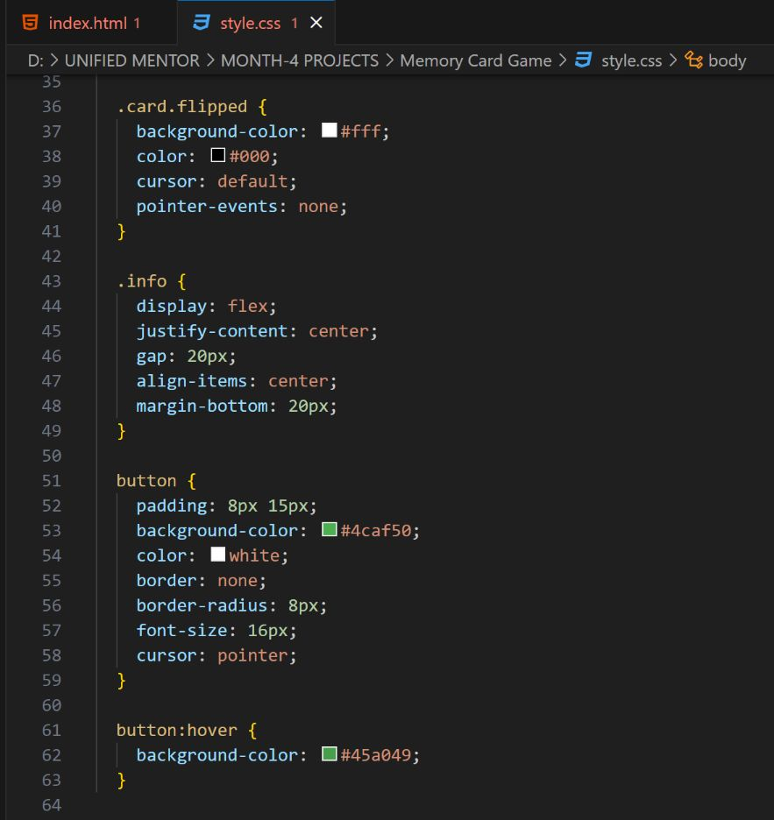
CSS code

Slide 8

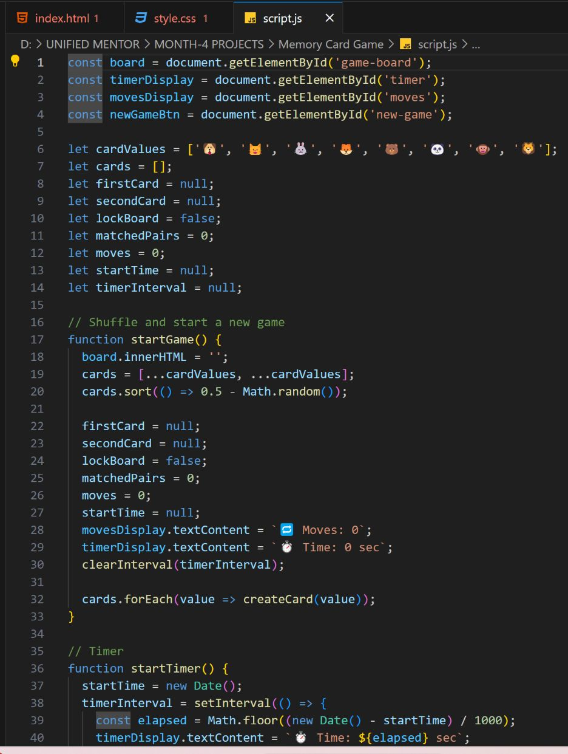
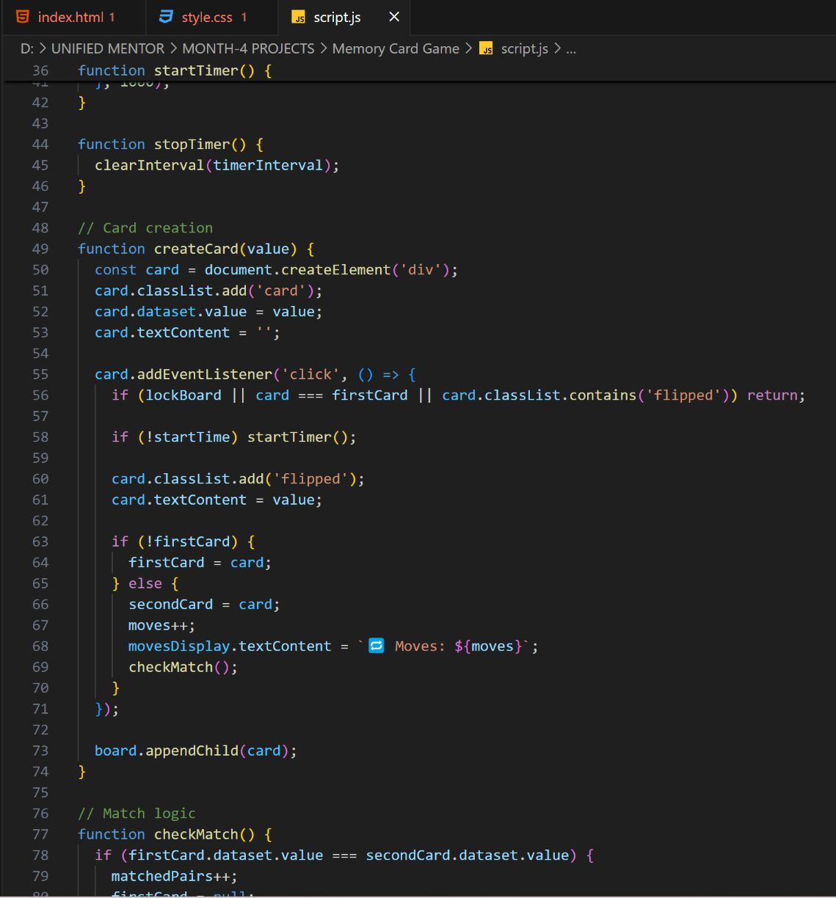

JavaScript code

Slide 9

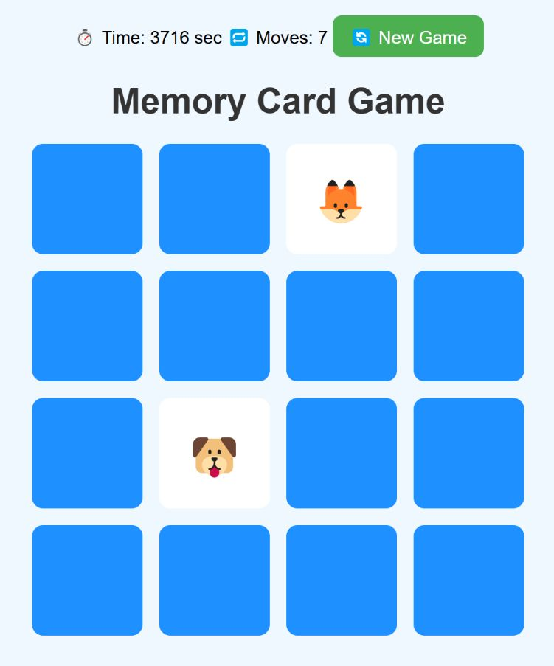
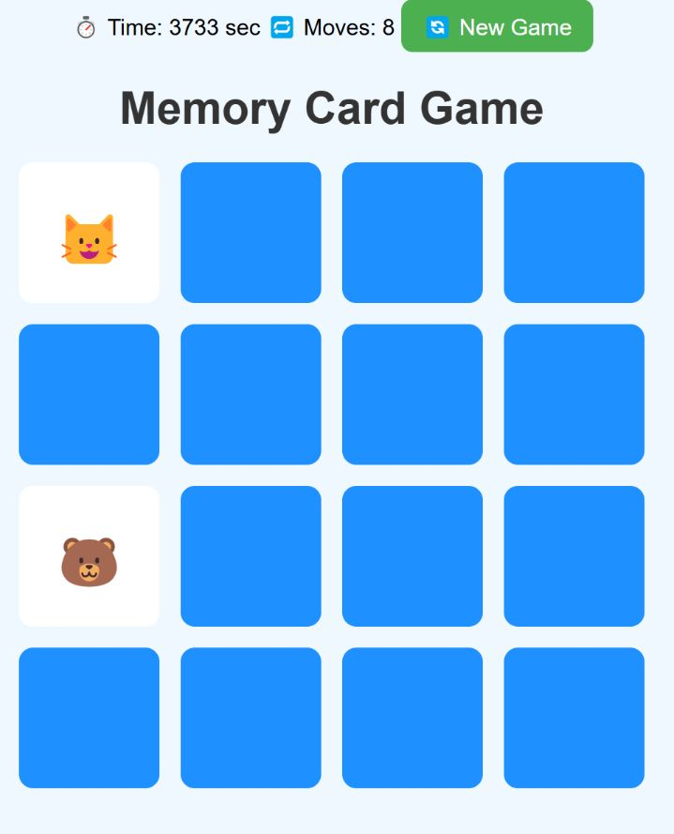
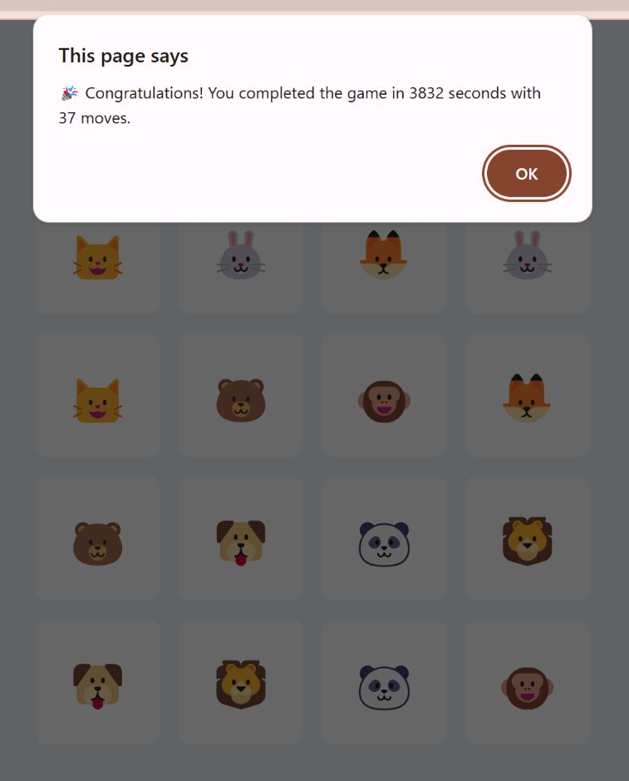
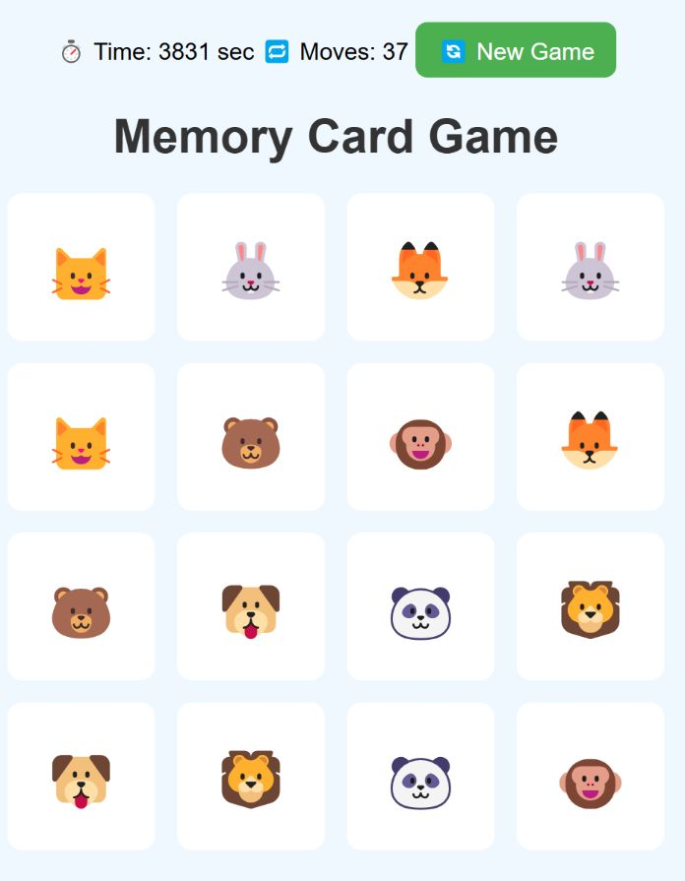
Project Output:
for the structure of the game board and elements
for styling and animations to enhance visual appeal
for the game logic, such as card flipping, matching, and scoring

Slide 10
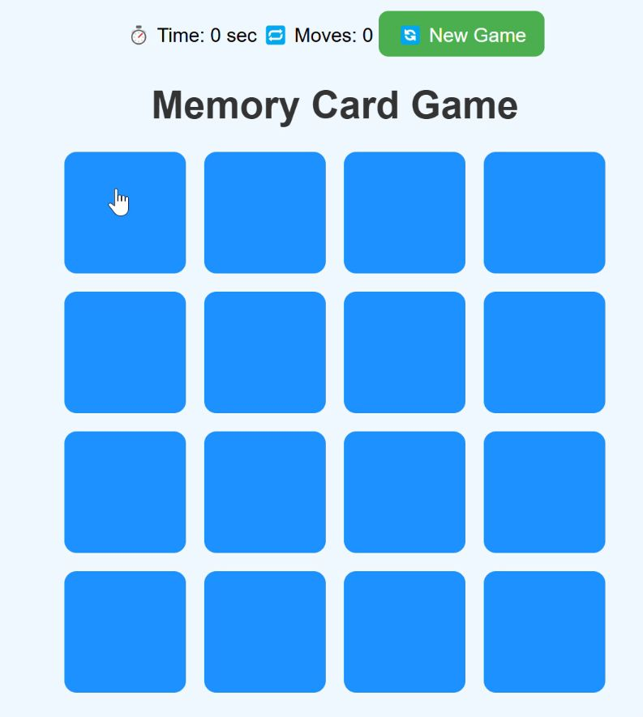
Functional Output Video

Slide 11
Conclusion
The Memory Card Game is a simple yet engaging project that showcases the power of combining HTML, CSS, and JavaScript to build an interactive and visually appealing web application. Through this project, key concepts such as DOM manipulation, event handling, animations, and game logic were implemented effectively.
It serves as a great example of how basic web technologies can come together to create a smooth user experience and reinforce essential programming skills. This game not only enhances cognitive abilities like memory and focus but also provides a solid foundation for more advanced web development projects in the future.

Slide 12
🔧 Future Enhancements
To make the Memory Card Game even more engaging and feature-rich, the following enhancements can be considered for future development:
Difficulty Levels: Add multiple difficulty modes (Easy, Medium, Hard) with varying grid sizes and number of cards.
Score System: Implement a scoring system based on time taken and number of moves.
Leaderboard: Add a local or global leaderboard to display high scores and encourage competition.
Themed Decks: Introduce card themes (e.g., animals, emojis, superheroes) for a more personalized experience.
Sound Effects & Music: Enhance user experience with background music and flip/match sound effects.
Animations & Transitions: Add smoother transitions and celebratory animations when the game is completed.
Mobile Optimization: Improve responsiveness and touch controls for mobile users.
User Authentication: Allow users to log in and save their progress or scores.
Dark Mode: Provide a dark/light theme toggle for better accessibility.

Slide 13
Social Media Links
Website Link: Memory Card Game
Github Link:

Slide 14


